Slide 1

“Bye Bye WCF, Hello gRPC”

Slide 2
.NET Schedule
July 2019
.NET Core 3.0
RC
Sept 2019
.NET Core 3.0
Nov 2019
.NET Core 3.1
LTS
Nov 2020
.NET 5.0
Nov 2021
.NET 6.0
LTS
Nov 2022
.NET 7.0
Nov 2023
.NET 8.0
LTS
.NET Core 3.1 = Long Term Support (LTS)
.NET 5.0 release in November 2020
Major releases every year, LTS for even numbered releases
Predictable schedule, minor releases if needed

Slide 3
What didn’t make through .NET Core 3.x
WebForms
Blazor
WCF
gRPC
Workflow Foundation
?

Slide 4
WCF – Windows Communication Foundation
Framework for building SOAs
SOAP over HTTP
WCF
Java
Python

Slide 5
Evolution of WCF
WCF with NetTCP
A new TCP-based network protocol for high-performance communication
WCF
WCF
WCF

Slide 6
Motivation for gRPC
Stubby
Google has been using a single general-purpose RPC infrastructure called Stubby to connect the large number of microservices running within and across our data centers for over a decade.
SPDY
Open-specification networking protocol that was developed primarily at Google for transporting web content with goal of reducing web page load latency and improving web security.
Source: https://grpc.io/blog/principles/

Slide 7
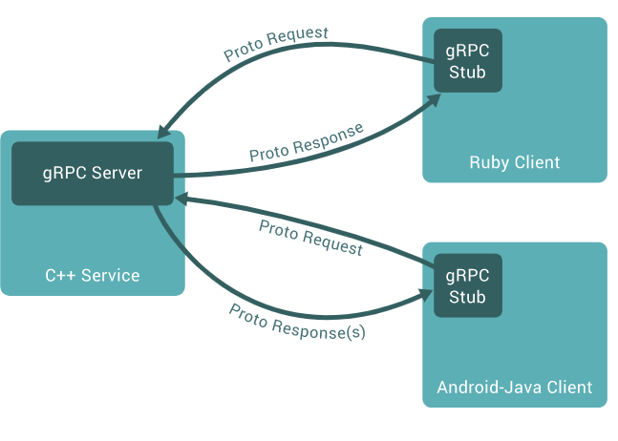
Intro to gRPC
g - Remote Procedure Call
HTTP/2
Binary transmission
Benefits
SOAP Interoperability
Performance of NETTCP
Source : https://grpc.io/docs/guides/

Slide 8
Language Support
Objective C
C++
Python
Ruby
Go
Java
PHP
C#
Node.Js
Swift
Kotlin
Dart
Haskell
Homebrew

Slide 9
Mode of Streaming
Unary (Request / Response)
Server-Streaming
Client-Streaming
Bidirectional-Streaming

Slide 10
Protobuf
Serialization framework
Interface Definition Language (IDL)
Message Interchange Format
Binary message format

Slide 11
Limitations
Limited browser support
Not human readable

Slide 12
gRPC in .NET Core 3.x
First party support by Google
Managed implementation by Microsoft

Slide 13
gRPC Hands-On
Greeter Service

Slide 14
What’s next ?
gRPC-Web
https://grpc.io/docs/tutorials/basic/web/

Slide 15
Useful Links
https://docs.microsoft.com/en-us/aspnet/core/grpc/?view=aspnetcore-3.0
https://dotnet.microsoft.com/learn/aspnet/architecture#ebook-grpc-for-wcf-devs-swimlane
https://channel9.msdn.com/Shows/The-Cloud-Native-Show/Building-Microservices-with-gRPC-and-NET?term=GRPC&lang-en=true
https://channel9.msdn.com/Shows/Visual-Studio-Toolbox/Introduction-to-gRPC?term=GRPC&lang-en=true
https://grpc.io/docs/tutorials/basic/web/
https://grpc.io/docs/tutorials/basic/csharp/
https://github.com/grpc/

